Slide 1
STUDENTS CREDENTIALS SHARING BASED DECENTRALIZED APPLICATION
GROUP IV
Guide : Asst.Prof.Rahul Gopal

Slide 2
GROUP MEMBERS
ADITYA R NAIR (STC20CS006)
ANN MARIA SUNNY(STC20CS018)
NADAR NAWAS (STC20CS040)
STEEVE BINU BABY(STC20CS055)

Slide 3
CONTENT
1) ABSTRACT
2) INTRODUCTION
3) SRS

Slide 4
ABSTRACT
In the era of digital transformation, traditional methods of verifying and sharing academic credentials face numerous challenges, including fraud, inefficiency, and a lack of transparency. This abstract outlines the development of a decentralized application (DApp) utilizing blockchain technology to securely manage and share student credentials .This introduces a novel approach to credential sharing by leveraging the power of blockchain, specifically Ethereum, to create a tamper-proof, transparent, and user-centric system. In this decentralized ecosystem, students are given ownership of their academic records, ensuring privacy and control over their data .

Slide 5
INTRODUCTION
Most digital credential sharing schemes adopt centralised storage and management of credentials and associated keys, which could lead to a single point of failure and high security risks.
If data sharing is unavoidable, one approach to strengthen privacy is to minimize the data being disclosed.
Our design is flexible in that the user has full control of the credentials .
To increase the scalability, the proposed system uses a secure off-chain storage mechanism(IPFS). The performance and viability of the proposed architecture is analyzed by using an Ethereum based prototypical implementation.

Slide 6
SRS
LANGUAGES USED
Web3js
Metamask
Solidity
React
node.js

Slide 8
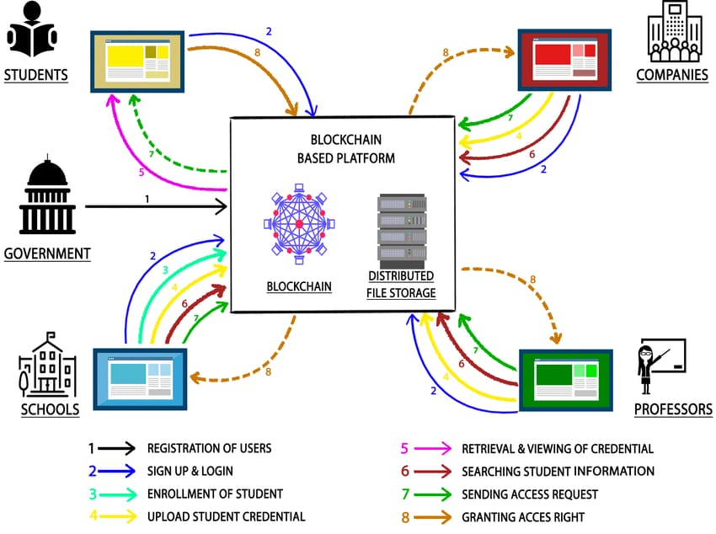
DESIGN

